Slide 1
Actuarial Science
KARTIK SHARMA
JAISHVIN KAUR
MAHIMA DOSHI
NISTHA RULANIA
MENTORED BY:
ROUDRA SIR

Slide 2
Simulation of Employee Benefits Plan

Slide 3
What are Employee Benefits?
Employee benefits are defined as indirect, cash or non-cash compensations paid to an employee above and beyond regular salary or wages.

Slide 4
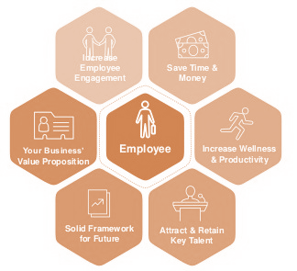
Need for Employee Benefits

Slide 5


Slide 6
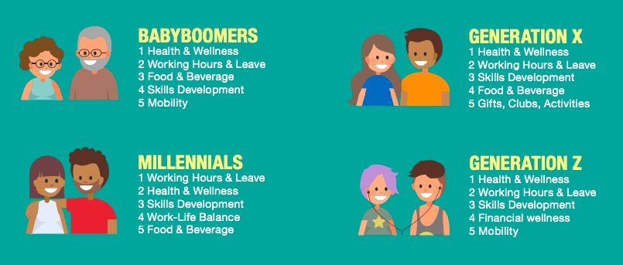
Most Appreciated Employee Benefits

Slide 7
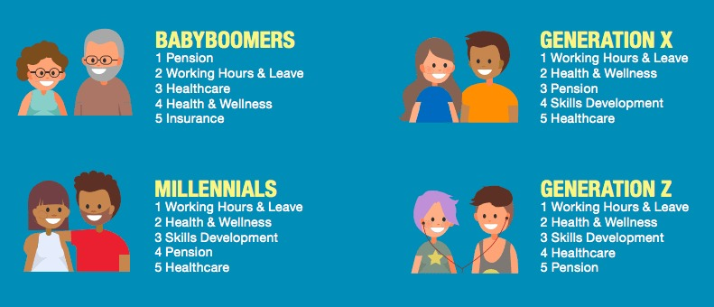
Most Important Employee Benefits

Slide 8
Safelane
Insurance
Moments of Caring Future

Slide 9
Safelane Insurance aims at providing a happy and secured life to its customers through life and non-life insurance.
Similarly, we aim at providing a secure life to our employees as well in the form of employee benefit. We have a staff of 65 people at present and we believe that our staff is of utmost importance to us and to thank them we provide many benefits to them.

Slide 10
SAFELANE
INSURANCE
Administrative
Level
Executive Level
Operational
Level
Junior
Level
8
Employees
17
Employees
14
Employees
26
Employees

Slide 11
COMPULSORY BENEFITS TO THE EMPLOYEES
Leave of Absence is employee’s right
Workplace security
Life Insurance
Required retirement benefits and incentives
Worker’s compensation
Maternity Benefit
Payment of Gratuity
Health Insurance

Slide 12
ADDITIONAL BENEFITS PROVIDED AT SAFELANE INSURANCE
Investment Plan
Free Membership at Safelane Club
Free Skill-development workshops
Basic Transportation Cost

Slide 13
Investment Benefit Plan

Slide 14
At Safelane insurance we provide a benefit plan to our employees through which we invest a certain proportion of their salary with a tenure (2-4 years) selected by the employee himself and then return the amount with interest after the selected tenure.

Slide 15
Investment of Salary
Salary (Per month) | Percentage
Greater than 4L | 15%
4L - 2.9L | 12%
2.9L - 1.5L | 10%
1.5L- 65k | 8%
Less than 65k | 7%

Slide 16
Calculation of Interest Rate
In order to calculate the interest rate we are using the following formula:
Where the investment code is:
Investment Bracket | Code
Greater than 30k | 4
30k - 10k | 3
Less than 10k | 2

Slide 17
Calculation of Sum Assured
We have calculated the sum assured using python and excel for the different employees at different tenures.

Slide 18
Insurance Director
Our company’s Insurance Director has a salary of Rs. 472000 and chooses his tenure as 4 years.
Since, his salary is more than 4 lakh so we invest 15% of his salary per month i.e,
472000*15% =70800 (P)
His investing code is 4 (as the invested amount is greater than 30k)
Therefore, Interest Rate = 1.75*4+0.75*4
= 10%
i = 0.10/12 (Since, calculating interest per month)
Now, Sum Assured =
S1 = P(1+i)
S2 = (S1+P)(1+i)
.
.
.
S48 = (S47 +P)(1+i)
Therefore, S48 is the sum assured he’ll get at the end of 4 years.

Slide 19
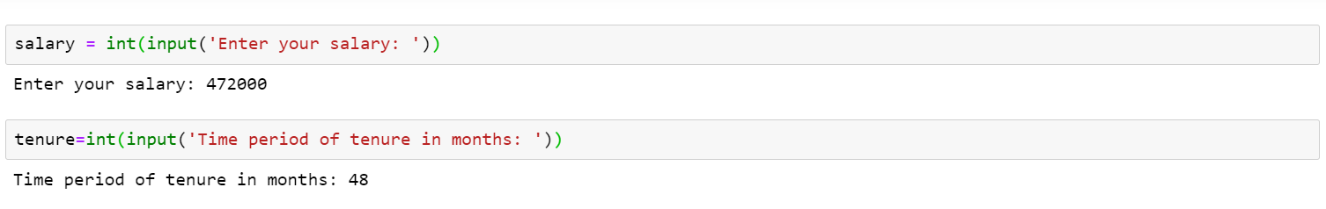
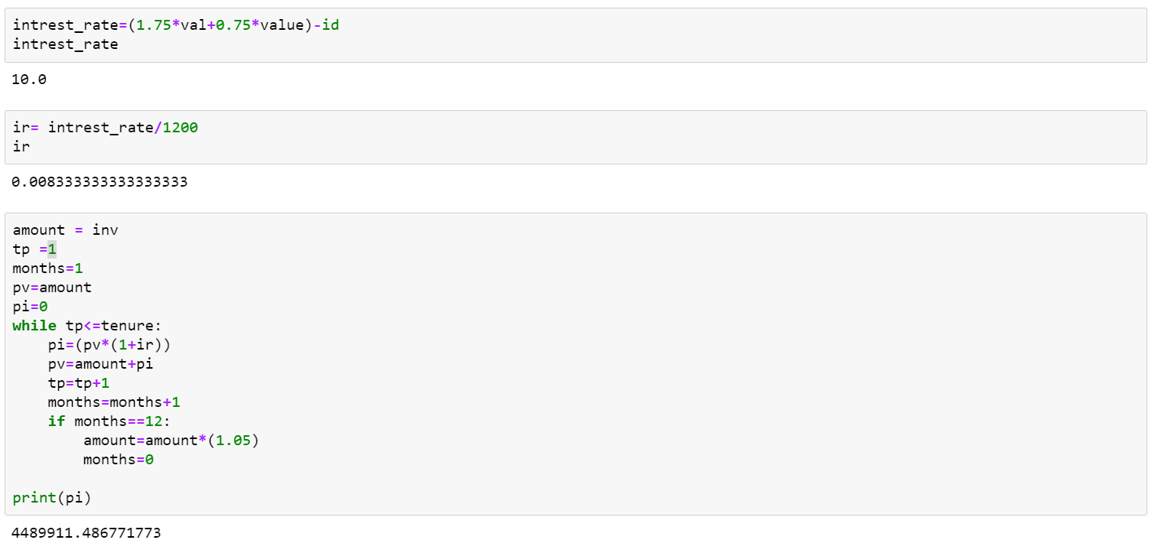

Slide 20
Age - 55 years
Salary (monthly) - Rs.472000
 | 4 years | 3 years | 2 years
Interest Rate (%) | 10 | 9.25 | 8.5
Sum assured | 4489911.487 | 3087766.262 | 1902635.827

Slide 21
Total amount Investment Procedure
EQUITY LARGER
(INDEX FUNDS)
EQUITY SMALLER
(PRIVATE EQUITY)
FIXED INCOME LARGER
(DEBT FUNDS & PF)
FIXED INCOME SMALLER
(ETF’s , BONDS)
HEDGING
ALTERNATIVE INVESTMENTS
(GOLD & COMMODITIES)

Slide 22
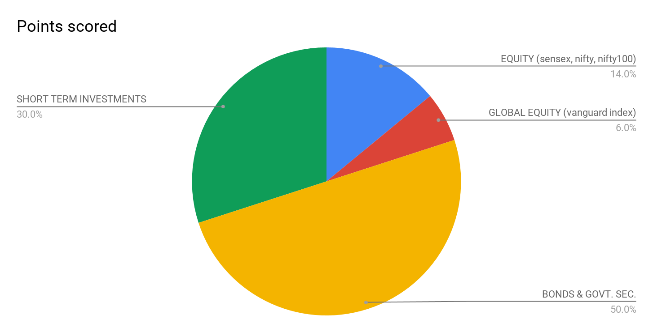
Types of Portfolios
Conservative Portfolio

Slide 23
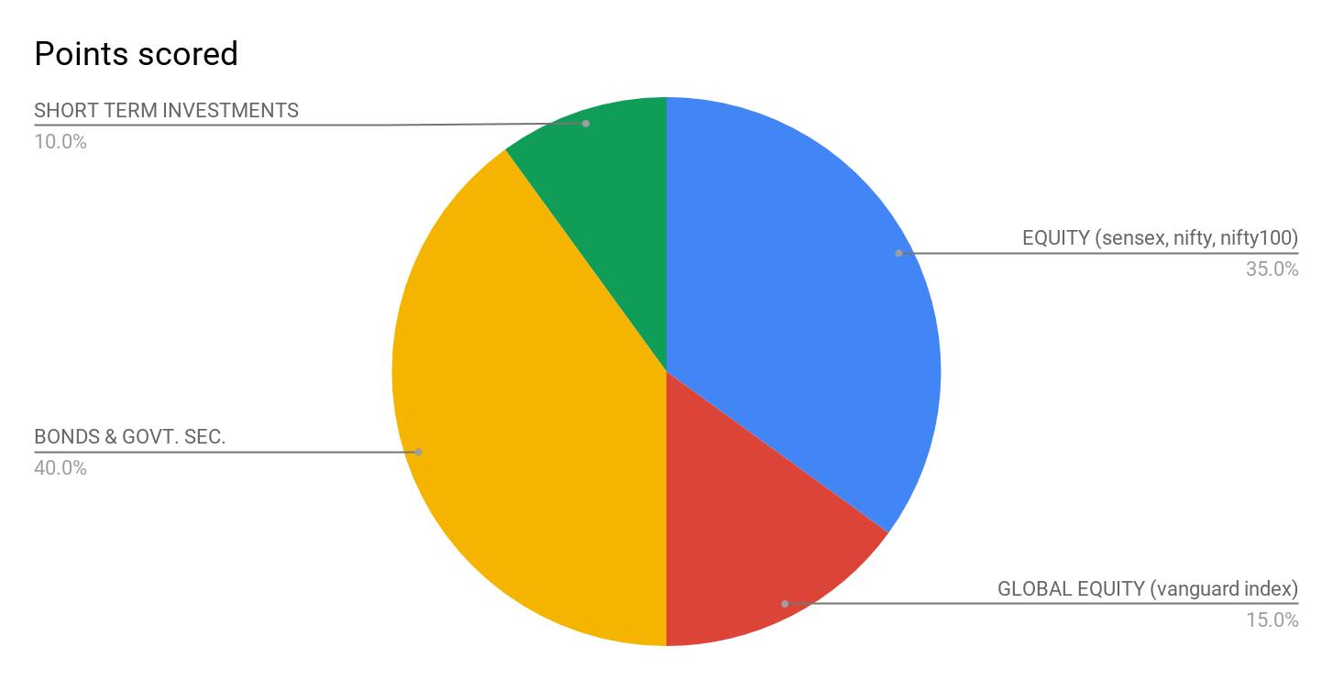
2. Balanced Portfolio

Slide 24
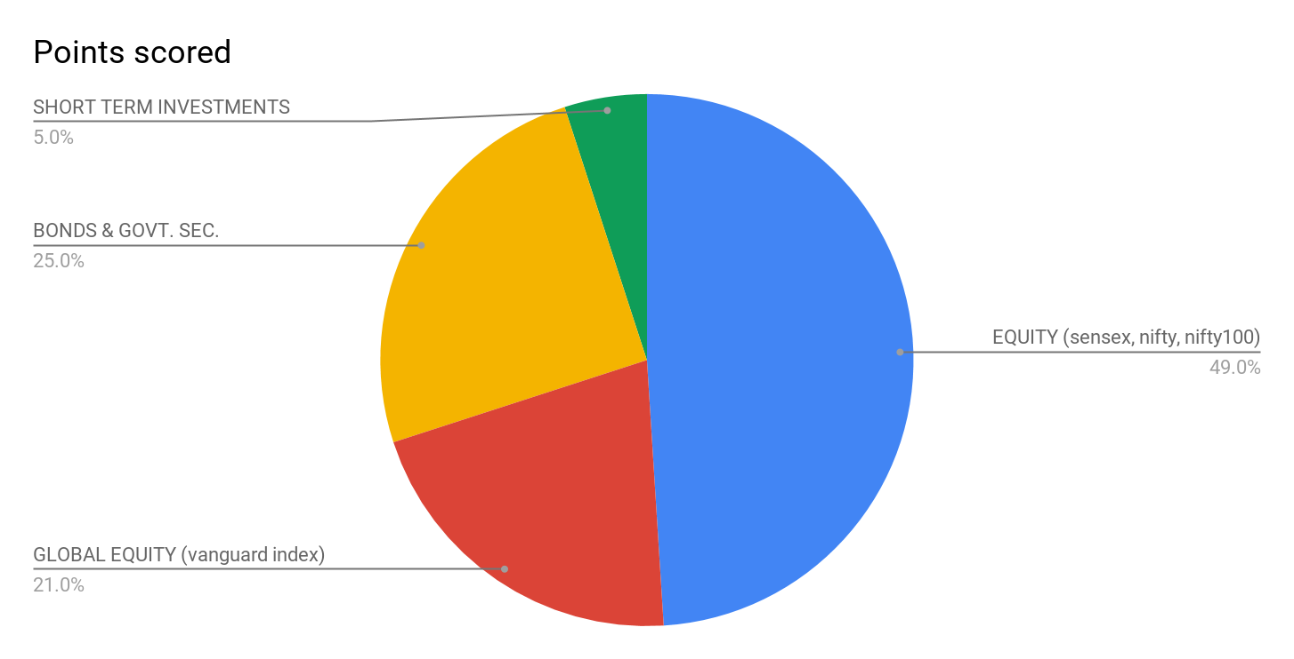
3. Growth Portfolio

Slide 25
Amount to be invested per month i.e., Rs. 889370 is invested through Safelane Portfolio Management Services at interest rate 12-15 % for 2-4 years.
Our approximate profit ranges from:
Rs. 11,00,ooo
To
Rs. 75,00,ooo
Whoa! That’s a big number!

Slide 26
Terms & Conditions
Any employee who has signed up for this plan has to compulsorily work for 2 years in the company.
Any employee in this plan if leaves before his/her tenure has been completed will not get the same sum assured instead the interest will be lowered by 1%.

Slide 27
Conclusion
We are proud to provide a comprehensive flexible and highly competitive benefits program as an important component of our total rewards package.
Employee benefits is one tool to make our team feel valued, appreciated, and loyal. Ranging from health benefits, to retirement savings, to flexible schedules employees want to work for a company that makes them feel secure and satisfied.
In conclusion, providing such an investment plan will be beneficial for employees and the company.
The plan will also increase our goodwill in the market.

Slide 28
Thanks!
Any questions?
You can find us at:
mahima.doshi@safelane.in
kartik.sharma@safelane.in
nistha.rulania@safelane.in
jaishvin.kaur@safelane.in

